Slide 1
PYTHON PROGRAMMING
LAUNCHCODE
August 2, 2025
Asfand Khan

Slide 2
Questions + Homework Review
https://github.com/Asfandyar-Khan/LaunchCode/
Contains syllabus
Contains lectures
Powerpoint files
Google Colab
Contains homeworks
Word document
To be completed prior to class
Any unfinished or challenging questions are taken up at the start of class
Any questions about using the input function?
Any questions about last week’s homework?

Slide 3
Knowledge Check
Question: School Trip Bus Planner
Ask the user:
1. How many students are going on the trip?
2. How many seats are there per bus?
3. The user’s name
Then calculate how many buses are needed (round up if necessary) and print something like:
"Liam is organizing a trip for 45 students and needs 3 buses!"
Hint: Calculate buses_needed = number_of_students / seats_per_bus

Slide 4
Review of Past Class
Week 3 Homework Review
Input Function
From basic input function questions to advanced
Using strings
Using numbers
Using a variable in a string
Chapter 3 Functions
What is a function?
What are some functions we have used already?
What is the syntax of a function?
How is a function called?
Building our own functions

Slide 5
Today We Will Cover...
Week 4 Homework Review
Review of Functions
Advanced Functions
Global vs. Local Variable
For Loop – What is it and how is it used?

Slide 6
What is a function?
So far we’ve looked at many different functions
print(), type(), int(), float(), str(), abs(), round()
A function is a sequence of statements that run when it is called
Python has many different built-in functions, like examples above
However, we can build our own functions!

Slide 7
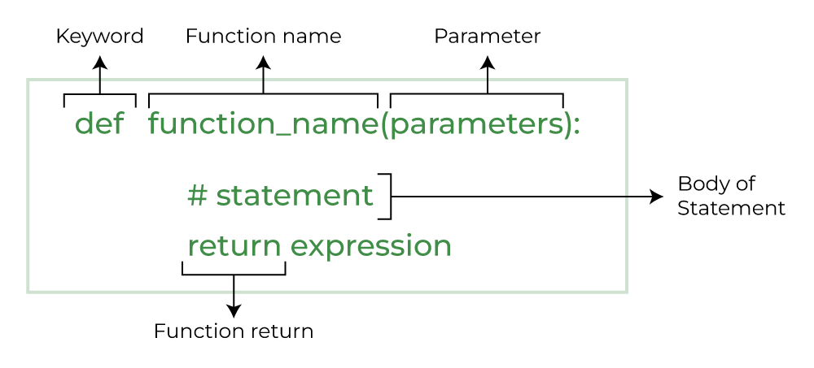
Defining New Functions
Function definition – helps us specify the function
Syntax: Does anyone want to guess what the bottom figure represents?

Slide 8
Defining New Functions, cont’d.
The keyword helps us initialize a function
The function name is the name which you use to call the function
The parameters include the number of variables within the function
The return is the value that comes out of the function
Notice the syntax/structure of how we name functions!

Slide 9
Defining New Functions, Example
Write a function that outputs a few of the introductory sentences we covered earlier in the class
def favourite_sentences():
print(“My name is Bob”)
print(“My age is 10”)

Slide 10
Functions - Parameters
def print_twice(string):
print(string)
print(string)
Notice how string is now added as a parameter
How does this function work?
What will happen if you call this function?
Can this function be called without any input?

Slide 11
Functions – Multiple Parameters
def repeat(word,n):
print(word*n)
There are now two parameters in our function
What will be the output of this function?
Does anyone want to demonstrate?

Slide 12
Functions – For Loops
A for loop iterates over a sequence – such as a string, list, or tuple
Allows you to run a block of code repeatedly
This occurs once for each item in the sequence
Syntax:
for item in iterable:
# Code to be executed for each item

Slide 13
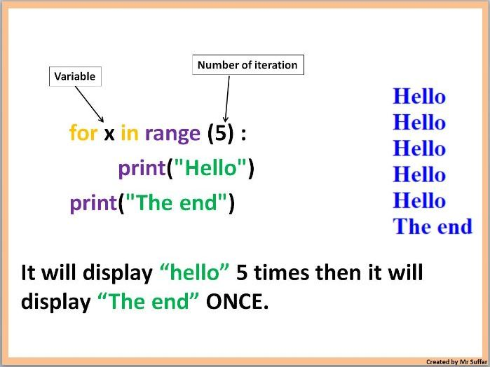
Functions – For Loops

Slide 14
Functions – For Loops, cont’d.
range() function
Commonly used in for loops
Only integers (whole numbers) can be used
Python built-in function that generates an unchangeable sequence of numbers
How is it used?
range(start,stop,step)
range(stop): this function will generate a sequence of numbers from 0 up to, but not including, stop

Slide 15
Functions – For Loops, cont’d.
range() function
range(start,stop,step): 3 parameters
range(start): initiate the sequence of numbers with the start number
range(stop): will generate a sequence of numbers from 0 up to, but not including, stop
range(step): will jump between start and stop numbers by increment of step

Slide 16
Python Data Type - Lists
Lists
Lists are a data structure that is used to collect data items
They are mutable (changeable)
Lists maintain a defined order
The first item is given priority
Then the second item, and so on...

Slide 17
Review and Questions
Homework will be posted tomorrow!
Asfand Khan

